Slide 1
1.Name - Pinky Biswas
Id - 1621276042
2.Name: : Dipu Chandra Malo
Id: 1712419642
3.Name: Khorshadul Islam
Id:1521333642
4.Name:Fahad Ahmed Pranto
ID: 1612607042

Slide 2
Javascript History
Everyone knows that JavaScript is eating the world. The problem is, there are lots of developers responsible for building software with JavaScript without a particularly deep knowledge of the language. It is easy to learn the basics and be productive, but newer programmers have a tendency to misuse some of JavaScript. Asynchronous JavaScript is particularly misunderstood. In this post, I will show you the most common ways to make asynchronous JavaScript calls and when to use each one. There are a lot of idiosyncrasies when using JavaScript in the browser, so for the purposes of this post, I will be discussing JavaScript on the server using Node.

Slide 3
Callbacks (The Old Way)
The setTimeout() function’s first parameter is a function to call when the timeout finishes. This is a simple example of a callback. The function passed is known as a “callback” function and the work being done asynchronously is the timer.

Slide 4
Promises (The Newer Way)
Promises were introduced to fix a lot of the problems with using callbacks to do asynchronous operations. A promise is just that: a promise to let the calling code know when the asynchronous call has finished.

Slide 5
Async/Await (The Newest Way)
The async keyword in JavaScript adds a whole new level of cool to promises: the await keyword! This can make your code much more readable because the await keyword lets the code end up reading like traditional synchronous JavaScript.

Slide 6
Because we’re studying on what is javascript and how it works . we select one easy game that is tic tac toe game.
Tic-tac-toe Xs and Os is a paper-and-pencil game for two players, X and O, who take turns marking the spaces in a 3×3 grid. The player who succeeds in placing three of their marks in a horizontal, vertical, or diagonal row is the winner.

Slide 7

The following example game is won by the first player, X:
In tic tac toe game , we implement javascript’s oldest way (callback ) and with out any error we successfully run thi game

Slide 8
Tic tac toe –creating unbeatable ai by using minimax algorithm.

Slide 9
What is minimax algorithm:
-Minimax is a recursive algorithm which is used to choose an optimal move for a player assuming that the opponent is also playing optimally.
-its goal is to minimize the maximum loss. This algorithm sees a few steps ahead and puts itself in the shoes of its opponent. It keeps playing ahead until it reaches a terminal arrangement of the board (terminal state) resulting in a tie, a win, or a loss.
Once in a terminal state, the AI will assign an arbitrary positive score (+10) for a win, a negative score (-10) for a loss, or a neutral score (0) for a tie.

Slide 10
How it works :
-return a value if a terminal state is found (+10, 0, -10)
-go through available spots on the board
-call the minimax function on each available spot (recursion)
-evaluate returning values from function calls
-and return the best value

Slide 11
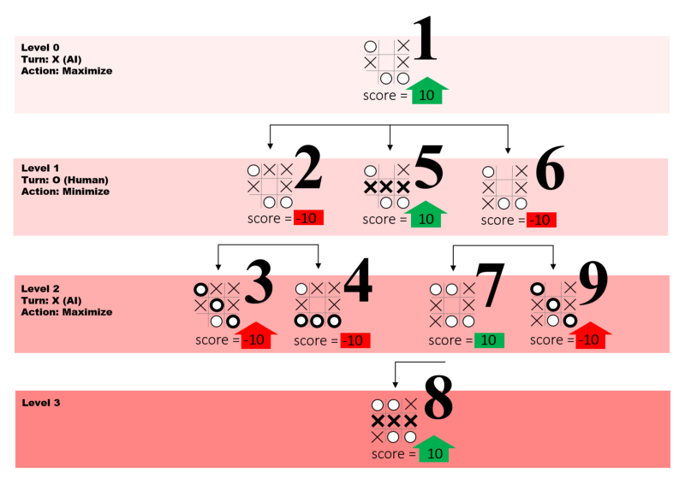
IN this FIGURE , LARGE NUMBERS REPRESENT EACH FUNCTION CALL AND LEVELS REFER TO HOW MANY STEPS AHEAD OF THE GAME THE ALGORITHM IS PLAYING.

Slide 12
5x5 Tic-tac-toe Ai vs human
- we will build Ai vs human tic-tac-toe 5x5 where ai never lose with minimax algorithm.
- Compare this game with the previous one In terms of time complexity.

Slide 13
Complexity of Minimax Algorithm
Minimax algorithm that searches game trees. It assumes that the players take alternate moves. The time complexity of Minimax is O(b^m), where b is the number of legal moves at each point and m is the maximum depth of the tree.

Slide 14
Comparison
For 3x3 board needs minimum 9! (factorial approximately 3,68,000) function calls to calculate best move for every iteration .
On the other hand, 5x5 board needs minimum 25! (factorial approximately 1.55*10^25) function calls to calculate best move for every iteration . It just goes exponentially as the board size goes up.

Slide 15
Improvement
There is a scope for improvement in 5*5 board. Fortunately, making the actual minimax decision is feasible without even looking at every game tree node. Therefore , without evaluating we delete nodes from the tree and this process is called pruning (alpha-beta pruning) .

Slide 16
Thank you

